Slide 1
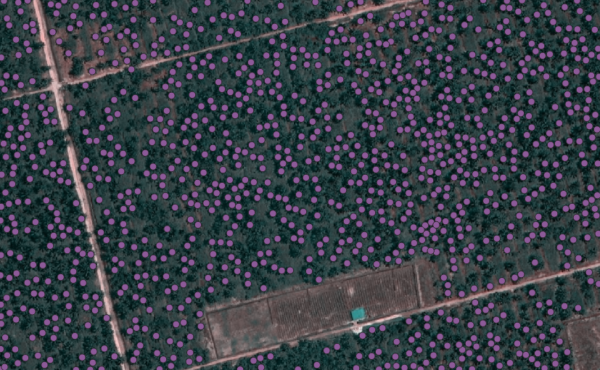
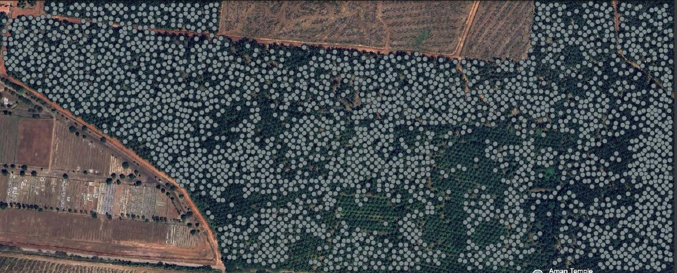
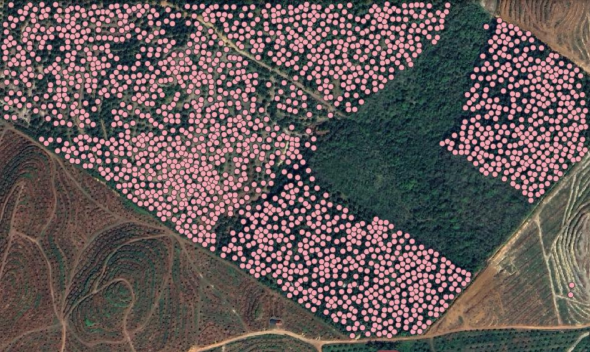
RESULT COMPARISON-PALM OIL TREE DETECTION
Google earth-30cm
Strengths:
High detection density: Most visible tree crowns are marked, showing strong model sensitivity.
Regular spacing: Indicates a plantation layout, and the detection aligns well with that grid.
Few false negatives: Most trees are marked, suggesting good recall.

Slide 2
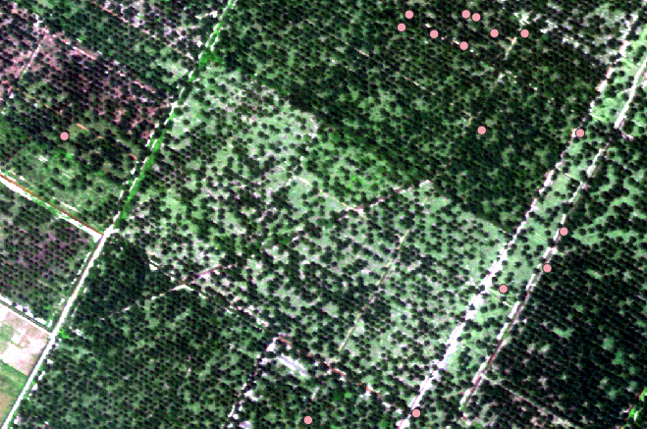
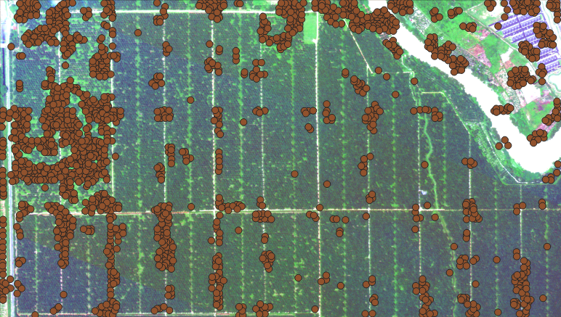
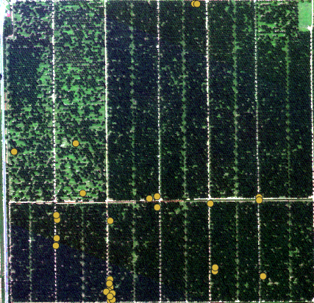
RESULT COMPARISON
Satellogic-50cm

Slide 3
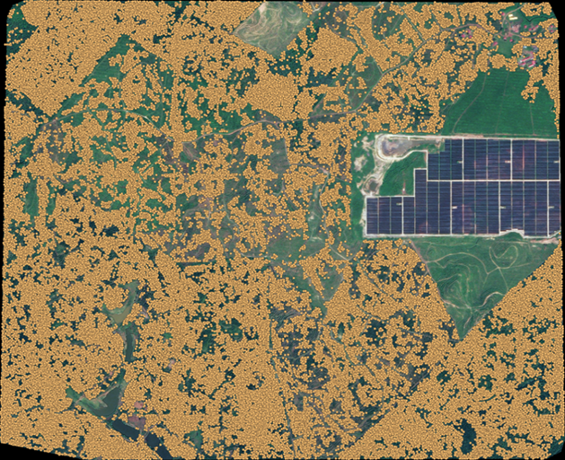
RESULT COMPARISON
EC2-50cm

Slide 4
Airbus | Satellogic | EC2
High detection density: Most visible tree crowns are marked, showing strong model sensitivity. | Most of the palm trees in this image are not detected.The background clearly shows many evenly spaced palm oil trees, especially in the central and lower-left areas.The model is missing over 90% of visible trees. | The model detects almost all visible crowns, especially in well-maintained palm blocks. Great performance in: Clear, regular plantations Open, high-contrast canopy areas In dense areas, some detections may overlap or cluster tightly. Risk: overcounting trees due to repeated or imprecise localization.
Regular spacing: Indicates a plantation layout, and the detection aligns well with that grid. Few false negatives: Most trees are marked, suggesting good recall. | The detection seems to fail in areas with mixed brightness and canopy density, like the central and left parts of the image. Possible confusion due to: Shade patterns Irregular spacing Lower contrast | High overall detection density, likely due to: Better visibility of crowns Stronger vegetation signal But it over-detects significantly, especially in: Solar panel field (top right): incorrectly marked as trees. Non-plantation areas: detections scattered even where tree presence is unlikely.
Potential Issues to Check: Overlap or duplicate detections: If multiple dots are on a single tree, it could inflate tree counts. Missed detections: Verify areas with dense canopy shadows — these might reduce detection accuracy. Precision of placement: Check if centroids are exactly on crown centers (important for biomass or yield estimation). | Struggles due to: Low crown visibility Possibly smaller or younger palms High shadowing or vegetation confusion Result: many real trees missed, few false positives. | False Negatives (Missed Palm Trees) Especially in areas where: Crowns are small or partially obscured Canopy visibility is low due to shadows, or low contrast Trees are newly planted or stunted Action: Visually inspect low-density detection areas with known plantation layout

Slide 5
Aspect | Airbus | Satellogic | EC2
Tree Crown Visibility | High | Low (faint/small crowns) | Moderate
Detection Density | Very High | Very Low | High (dense)
False Positives (FP) | Moderate (clusters, some spillover) | High | Medium (
False Negatives (FN) | Low | Very High (most trees missed) | Low
Alignment to Tree Rows | Moderate | Poor | Moderate (random scattering)
AOI Control / Masking | High | N/A (limited detections) | Moderate
Visual Clarity of Tree Rows | Clear | Faint / hard to detect | Clear in some plantation zones
Detection Confidence / Threshold Behavior | Possibly low threshold → over-detection in clusters | under-detection | Medium threshold → high sensitivity
Urban/Non-tree Confusion | few in non-tree zones | No clear evidence | Some detection in non tree zone
Usefulness for Inventory Mapping | Moderate — needs filtering | Low — not usable as-is | Moderate — needs moderate filtering

